Slide 1
Circuit Connection on Raspberry Pi Kit
Ms. Kritika Purohit
Assistant Professor
CSE

Slide 2
Introduction
A great way to get started with electronics and the Raspberry Pi is hooking up a red LED and making it blink using a Python script.
We will need the following tools to complete the project:
Raspberry Pi 3 setup with monitor and USB Mouse & Keyboard
Solderless breadboard
Jumper wires for easy hookup
Resistor pack
Red LED
Multimeter (optional)
Ms. Kritika Purohit
1

Slide 3





Ms. Kritika Purohit
1

Slide 4
Setting up the Circuit
The first step in this project is to design a simple LED circuit. Then we will make the LED circuit controllable from the Raspberry Pi by connecting the circuit to the general-purpose input/output (GPIO) pins on the Raspberry Pi.
A simple LED circuit consists of a LED and resistor. The resistor is used to limit the current that is being drawn and is called a current limiting resistor. Without the resistor the LED would run at too high of a voltage, resulting in too much current being drawn which in turn would instantly burn the LED, and likely also the GPIO port on the Raspberry Pi.
Ms. Kritika Purohit
1

Slide 5

To calculate the resistor value we need to examine the specifications of the LED. Specifically we need to find the forward voltage (VF) and the forward current (IF). A regular red LED has a forward voltage (VF) of 1.7V and forward current of 20mA (IF). Additionally we need to know the output voltage of the Raspberry Pi which is 3.3V.
We can then calculate the resistor size needed to limit the current to the LED’s maximum forward current (IF) using ohm’s law like this:
Ms. Kritika Purohit
1

Slide 6
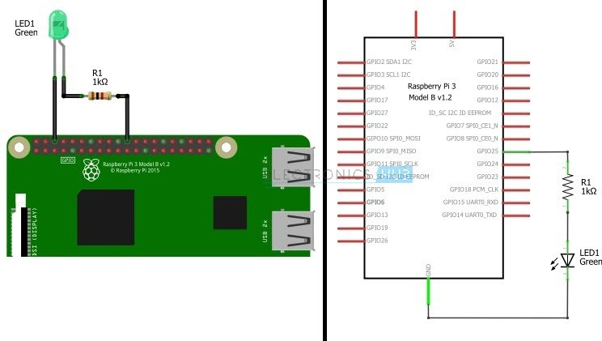
Ms. Kritika Purohit
1

Slide 7
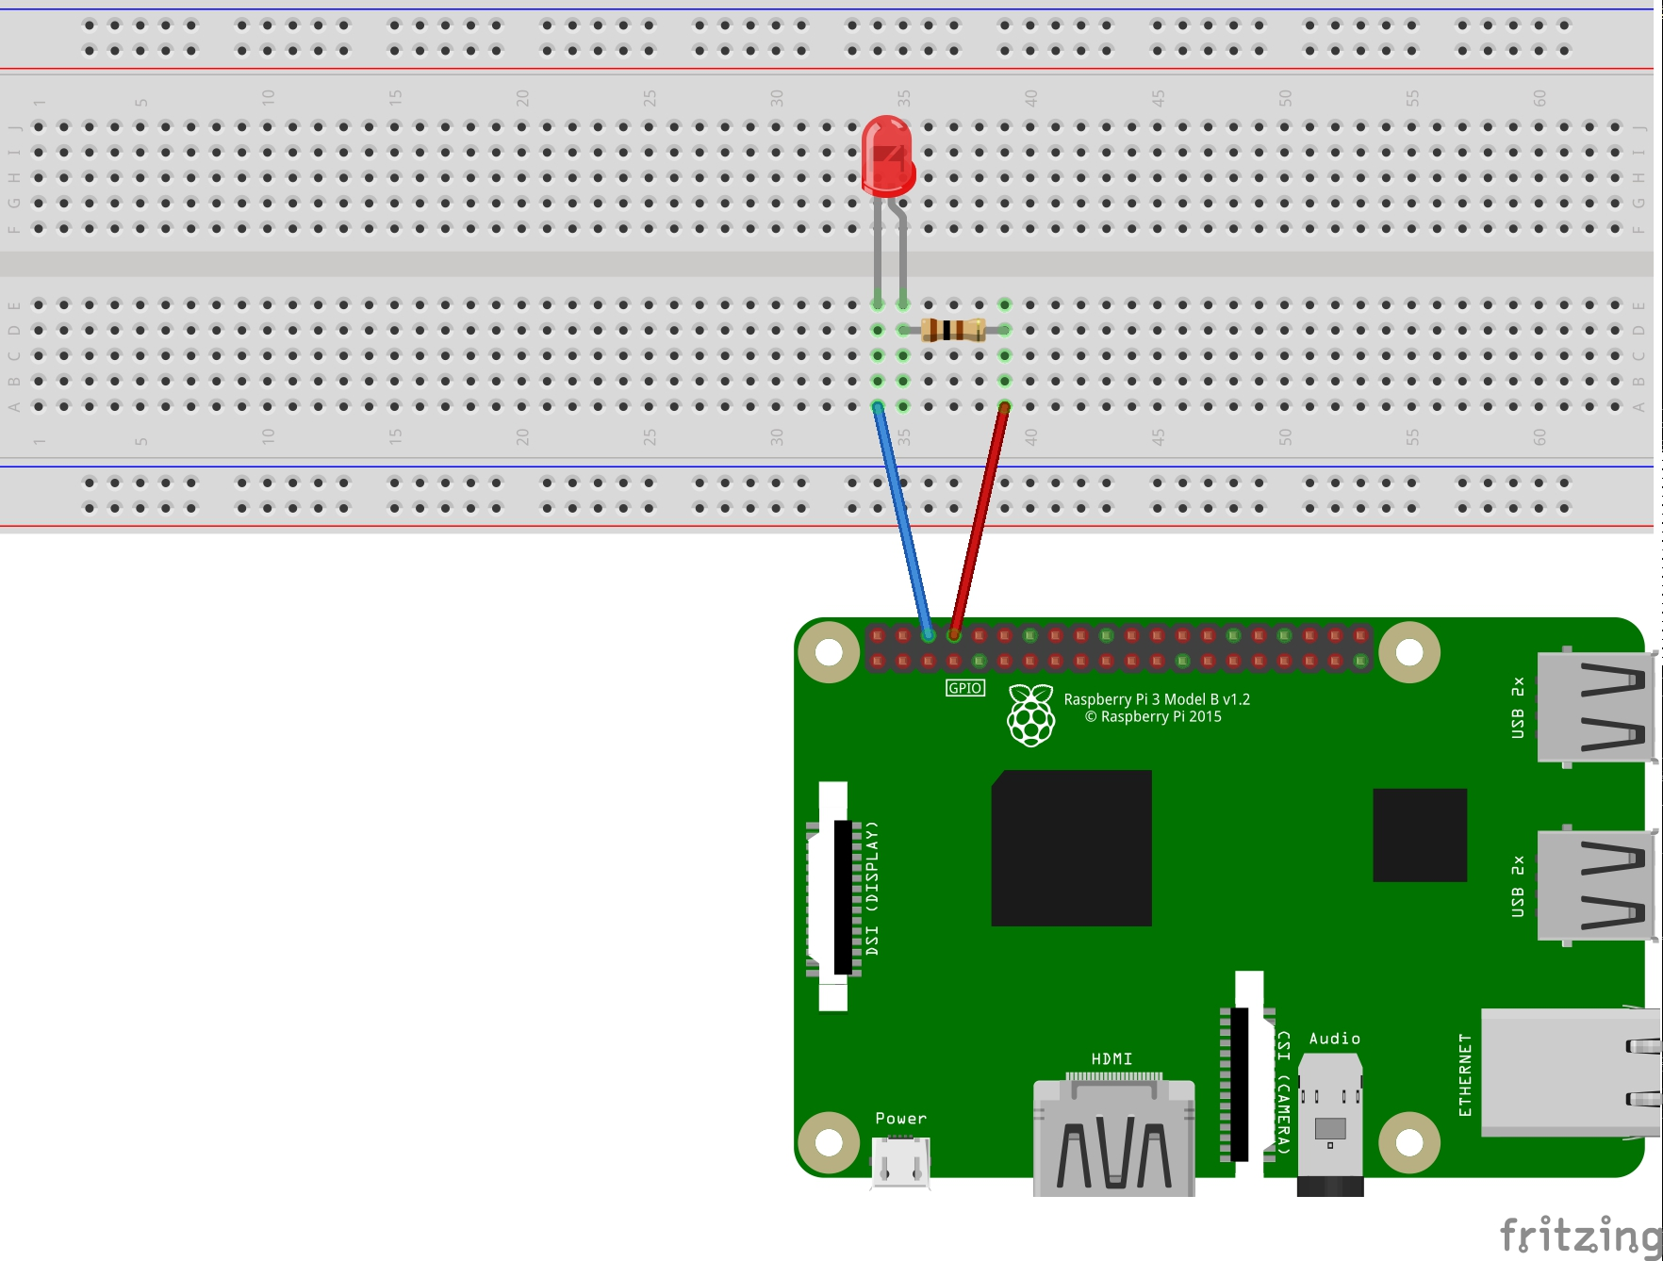
Ms. Kritika Purohit
1

Slide 8
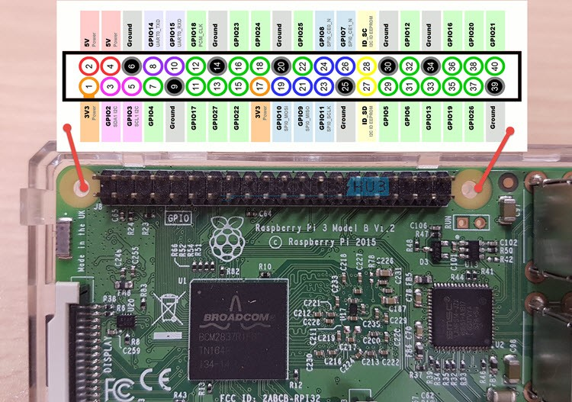
The numbers in the center (that are circled) are the Physical Pins of the Raspberry Pi. They are also called as Board Pins or Numbers. The GPIO Numbers (like Physical Pin 3 is GPIO2) are those which are seen by the Processor. This numbering is called as GPIO Numbering or BCM Numbering.
Ms. Kritika Purohit
1

Slide 9
Circuit Diagram of Blinking LED with Raspberry Pi
In order to Blink an LED using Raspberry Pi, we need to 2rst connect the LED to the Raspberry Pi. There are two ways you can connect your LED to the Raspberry Pi. I’ll show both ways of connecting the LED.
Circuit I- In the 1st circuit, the anode of the LED is connected to GPIO25 (Physical Pin 22) through a 1KΩ current limiting resistor. The cathode of the LED is connected to the GND Pin. In this circuit, the GPIO Pins will act as source and provides with 3.3V when it is activated.
Ms. Kritika Purohit
1

Slide 10
Ms. Kritika Purohit
1

Slide 11
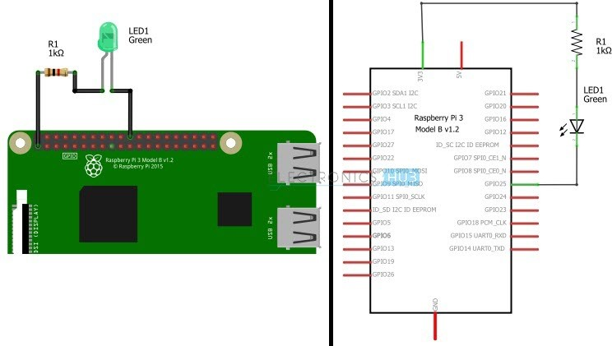
Circuit II- In this circuit, the anode of the LED is connected to the 3.3V supply pin of the Raspberry Pi through the 1KΩ resistor. The cathode of the LED is connected to GPIO25 (Physical Pin 22). In this circuit, the GPIO pin acts as the sink (GND).
Ms. Kritika Purohit
1

Slide 12
Circuit Principle
The principle of operation is very simple. The GPIO pin (GPIO25) is made HIGH for a second and is made LOW for the next second. This process is kept on loop so that we get effect of Blinking LED.
In order to control the GPIO Pin i.e. making it HIGH and LOW, I’ll be using Python programming and few Python Packages.
Ms. Kritika Purohit
1

Slide 13
How to operate the Blinking LED using Raspberry Pi?
First, I’ve used the Vim Editor for writing the Python Program. Vim is a Command Line Editor and is a very simple and easy to use text editor. First, login into your Raspberry Pi using SSH (like Putty for example).
To install the Vim Editor (by default, Raspbian has Vi editor and to get full features of Vim), enter the following code in the SSH Terminal.
sudo apt-get install vim
Now open a blank Python file using Vim editor with the file name being blinkLed.py. For this, use the following command.
sudo vim blinkLed.py
Ms. Kritika Purohit
1

Slide 14
After opening the blinkLed.py file, copy the following code and paste it there. Since it is a Python code, you need to be careful with the Tab characters as it is important to group the instruction as blocks in Python.
import RPi.GPIO as GPIO
import time
GPIO.setmode(GPIO.BOARD)
GPIO.setup(8,GPIO.OUT)
GPIO.setwarnings(False)
blink_interval=0.5
blink_count=10
for i in range(0,blink_count):
GPIO.output(8,True)
time.sleep(blink_interval)
GPIO.output(8,False)
time.sleep(blink_interval)
GPIO.cleanup()
Ms. Kritika Purohit
1

Slide 15
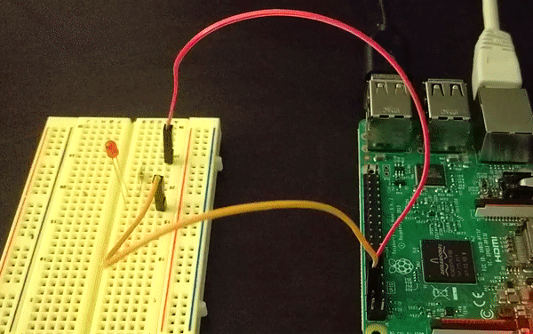
Ms. Kritika Purohit
<number>

